Slide 1


PLEDGE TO PROGRESS Sustainability Hackathon
Sponsored By
Your Team Name : Team Codewiser
Your team bio : Our highly skilled team consists of a Product Manager and two Senior Developers, with a proven track record of delivering leading products in the field of cloud technologies, AI and Sustainable Coding. With a history of successful product deliveries, we bring deep expertise and innovative thinking to develop cutting-edge solutions. Together, we are committed to delivering exceptional results with our collaborative and results-driven approach.
Date : 24/04/2023

Slide 2

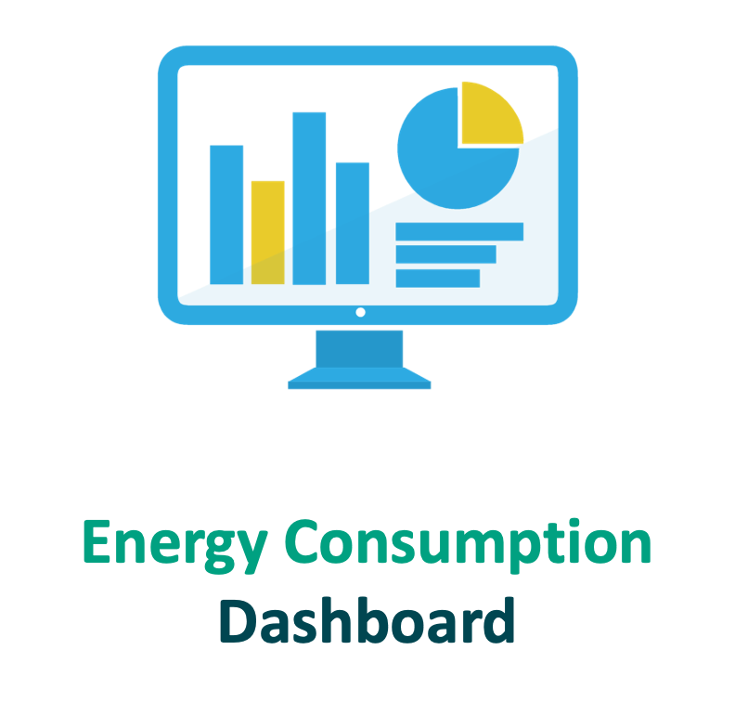

Problem Statement?
Why did you decide to solve this Problem statement?
As we all know, that if we can’t measure it, we can’t manage it. Hence, we want to bring complete transparency in sustainability. We want to bring code ledger similar to green ledger with which, developers will be able to get:
Real-time suggestion on writing the sustainable code,
Dashboard to get the total energy consumption and overall environmental impact of their application
And help the world run better and sustainable

Slide 3




User Segment & Pain Points
Which user /advertiser segment would be early adopter of your product & why?
Research says that software applications and it’s activities account for 4% of greenhouse gas emissions, a score that increases 8% year-over-year. Hence, each and every organization including software in this planet wants to reduce their carbon footprint. They want their applications to consume lesser energy but without impacting the performance of their applications. But the developers who are developing these applications lack the exposure towards how to write the code which consumes lesser energy.
Therefore, our early adaptors will the software organizations and their developers who want their applications to consume lesser energy and promote green coding practices.
Notes:
https://marmelab.com/blog/2020/11/26/argos-sustainable-development.html

Slide 4
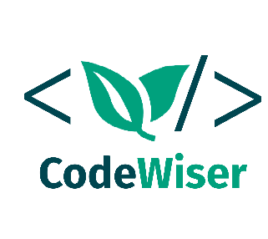



Pre-Requisite
What are the alternatives/competitive products for the problem you are solving?
Currently there are no alternatives/ competitive products available in the market which provides the features which our Tool- Codewiser proves.
Energy Consumption Scans
CodeWiser aims to use Blue Ocean Strategy and leverage early mover advantage.
Coding Practices
JEPO
Energy Efficient Coding Practices
Vulnerability Scans
*Code scanner market is comparatively very new, with currently no innovations in the area of measuring the energy efficiency of software applications. One of the popular start-up in the area of code scanning market like
“SonarQube” attracted 400+ Million USD investment.

Slide 5




Tools or resources
Azure tools or resources which are likely to be used by you for the prototype, if your idea gets selected
Azure App
Service
Azure Kubernetes
Service
Azure Database for PostgreSQL
Azure Devops

Slide 6
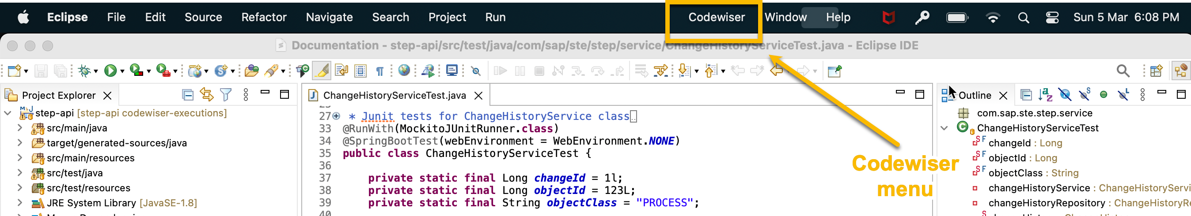
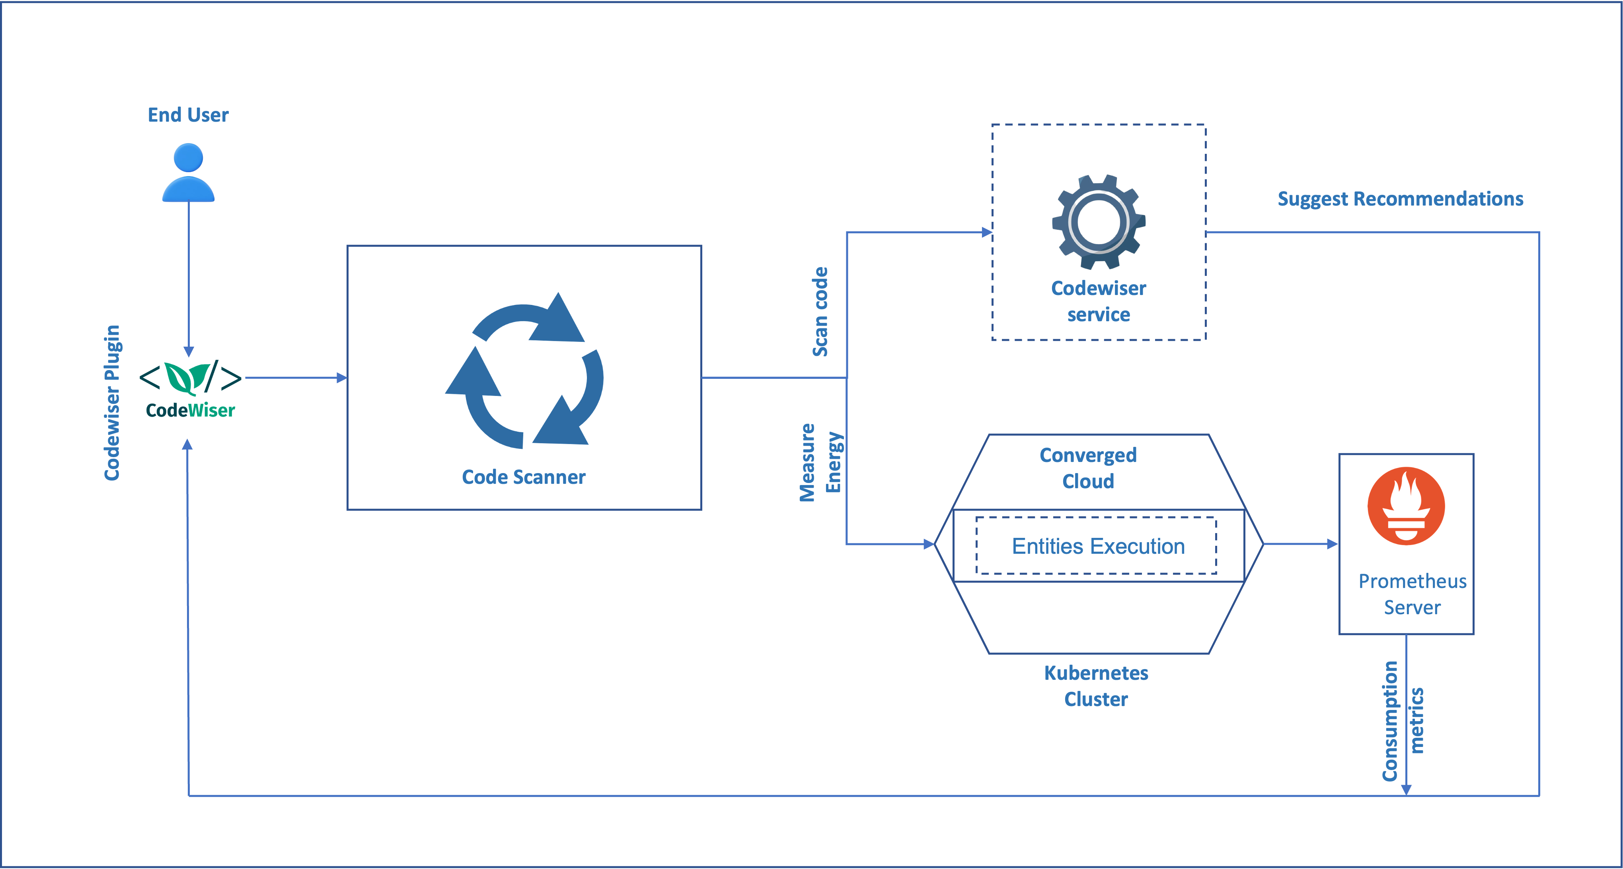
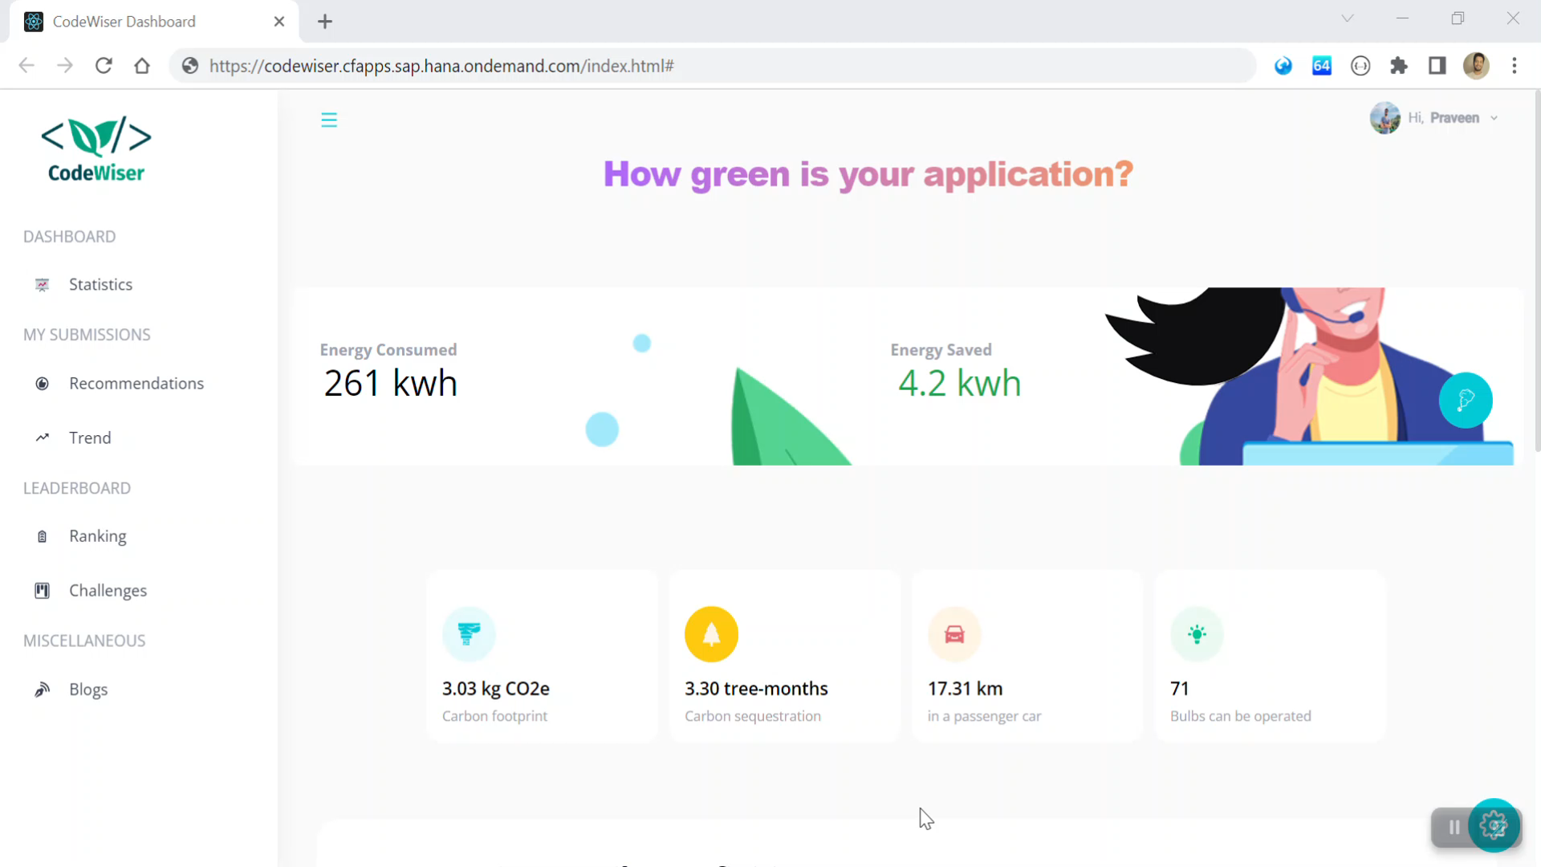
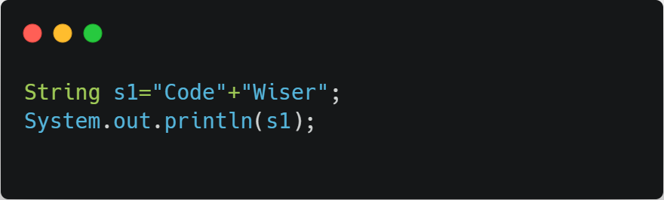

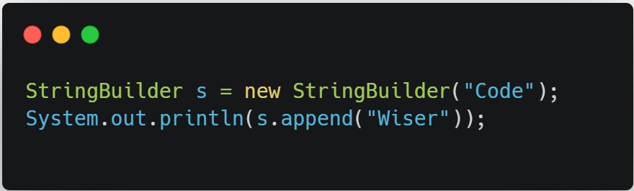

Any Supporting Functional Documents
Present your solution, talk about methodology, architecture & scalability

Slide 7
Key Differentiators & Adoption Plan
How is your solution better than alternatives and how do you plan to build adoption?
Currently there is no solution available in the market which provides all the features which Codewiser provides.
We will be developing this application as a Plugin, which can be included in any IDE.
Then, generate awareness in developers community about sustainable coding practices.
Onboard few developing teams to download our plugin and start writing coding practices.
Codewiser Plugin for Eclipse

Slide 8
GitHub Repository Link & supporting diagrams, screenshots, if any
How far it can go?
Codewiser aims to promote green coding practices among software developers and empower businesses to develop energy-efficient applications to achieve higher sustainability and profitability. The application provides real-time suggestions for energy-efficient coding, encouraging developers to make environmentally conscious decisions while coding. Codewiser also promotes sustainable coding practices by providing information on energy consumption and carbon emissions associated with coding practices. By promoting energy-efficient coding practices, Codewiser is helping to reduce the environmental impact of software development and promote sustainable growth.
Capabilities
Scan Active File: Scan Active Java editor to get recommendations
Scan Entire Project: Scan Entire Project to get recommendations
Measure Energy consumption: Measure Energy consumption of executable entities

Slide 9
Thank You
Team member names:
Ravikanth Malipeddu
Praveen Jha
Prabhat Kumar Singh

